Slide 1
Typescript

Slide 2
Agenda
What's Typescript?
Type Annotation
Functions
Class
Inheritance
Module
Interface
Generics
Declaration source files (*.d.ts)
New features

Slide 3
What’s Typescript?
JavaScript is not originally designed for large complex applications (mostly a scripting language, with functional programming constructs), lacks structuring mechanisms like Class, Module, Interface.
Typescript is a typed superset of JavaScript that compiles to plain JavaScript.
Adds additional features like Static Type (optional), Class, Module etc. to JavaScript
Microsoft technology.
Open Source.
Versions.
First made public in October 2012.
Latest version - Typescript 1.7.

Slide 4
Type Annotation
Any
Any Type is a super set of all types
var x : any;
var y;
Primitive
Number
Does not have separate integer and float/double type.
var num : number = 20;
var num = 20;
String
Both single quote or double quotes can be used.
var name : string = “hello”;
var name =’hello’;
Bool
var isOpen =true;

Slide 5
Type Annotation
Void
Used as the return type of functions that don’t return any value
Object Types
class, interface, module.
Array
Array types can be written in:
var list: number[] = [1, 2, 3];
var list: Array<number> = [1, 2, 3];
var list:any[] = [1, true, "free"]
Enum
enum Color { Red, Green, Blue };
var color = Color.Blue;

Slide 6
Type Annotation
Tuple
Tuple types allow you to express an array where the type of a fixed number of elements is known.
var x: [string, number];
x = ['hello', 10];

Slide 7
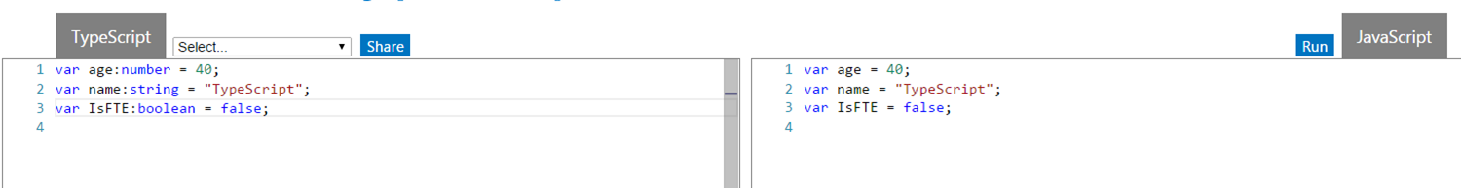
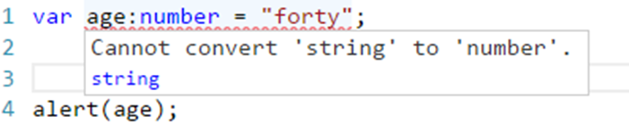
Type Annotation
Design time feature. No additional code is emitted in the final JavaScript that TypeScript compiler produces.
If there’s a type mismatch TypeScript shows a warning.

Slide 8
Functions
Type Annotation for parameter and return type.
Optional and Default Parameter.
Function Overloads.
Fat Arrow functions.
Rest parameters.
denoted by ‘...argumentName’ for the last argument allow you to quickly accept multiple arguments in your function and get them as an array.

Slide 9
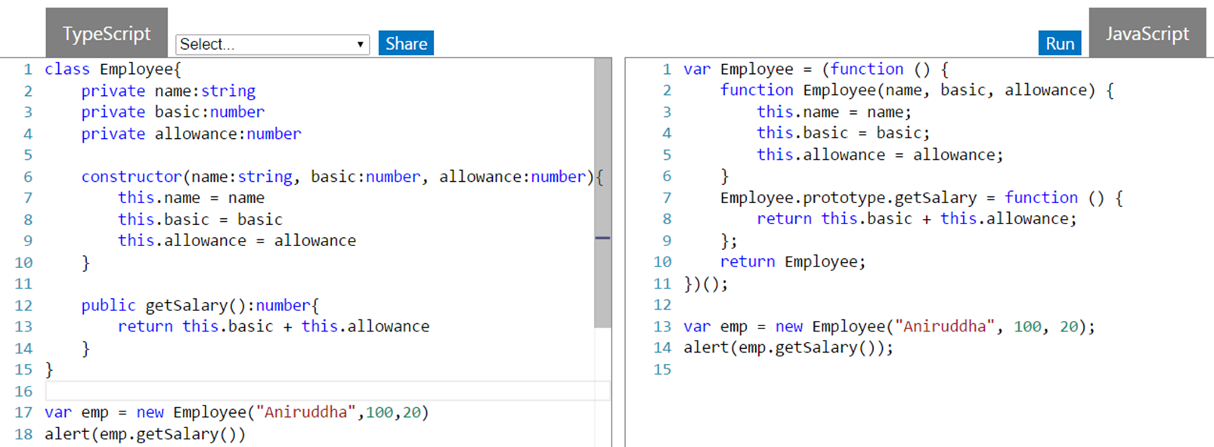
Class
Properties and fields to store data
Methods to define behavior

Slide 10
Inheritance
Typescript supports inheritance of class through extends keyword
super keyword.

Slide 11
Module
Modules can be defined using module keyword.
A module can contain sub module, class, interface or enum.
Class, Interfaces , functions can be exposed using export keyword.
Adding file references. - /// <reference path=“filename.ts" />

Slide 12
Interface
Declared using interface keyword
TS compiler shows error when Interface signature and implementation does not match
Optional properties can be declared for an interface (using ?)

Slide 13
Generics
Able to create a component that can work over a variety of types rather than a single one.
function identity<T>(arg: T): T {
return arg;
}
type argument inference - we want the compiler to set the value of T for us automatically based on the type of the argument we pass in.

Slide 14
Declaration source files (*.d.ts)
The purpose of these files is to provide some typing information for JavaScript libraries.
These files do not compile to .js files, simply describe their JavaScript implementations, and act as their representative.
Contains typing info.

Slide 15
New features
await & async
for..of – iteration.
Exponentiation operators - ** and **=
Spread operator

